Slide 1
Linking QSAR-Based Drug-Target prediction with AlphaFold
George Iniatis

Slide 2
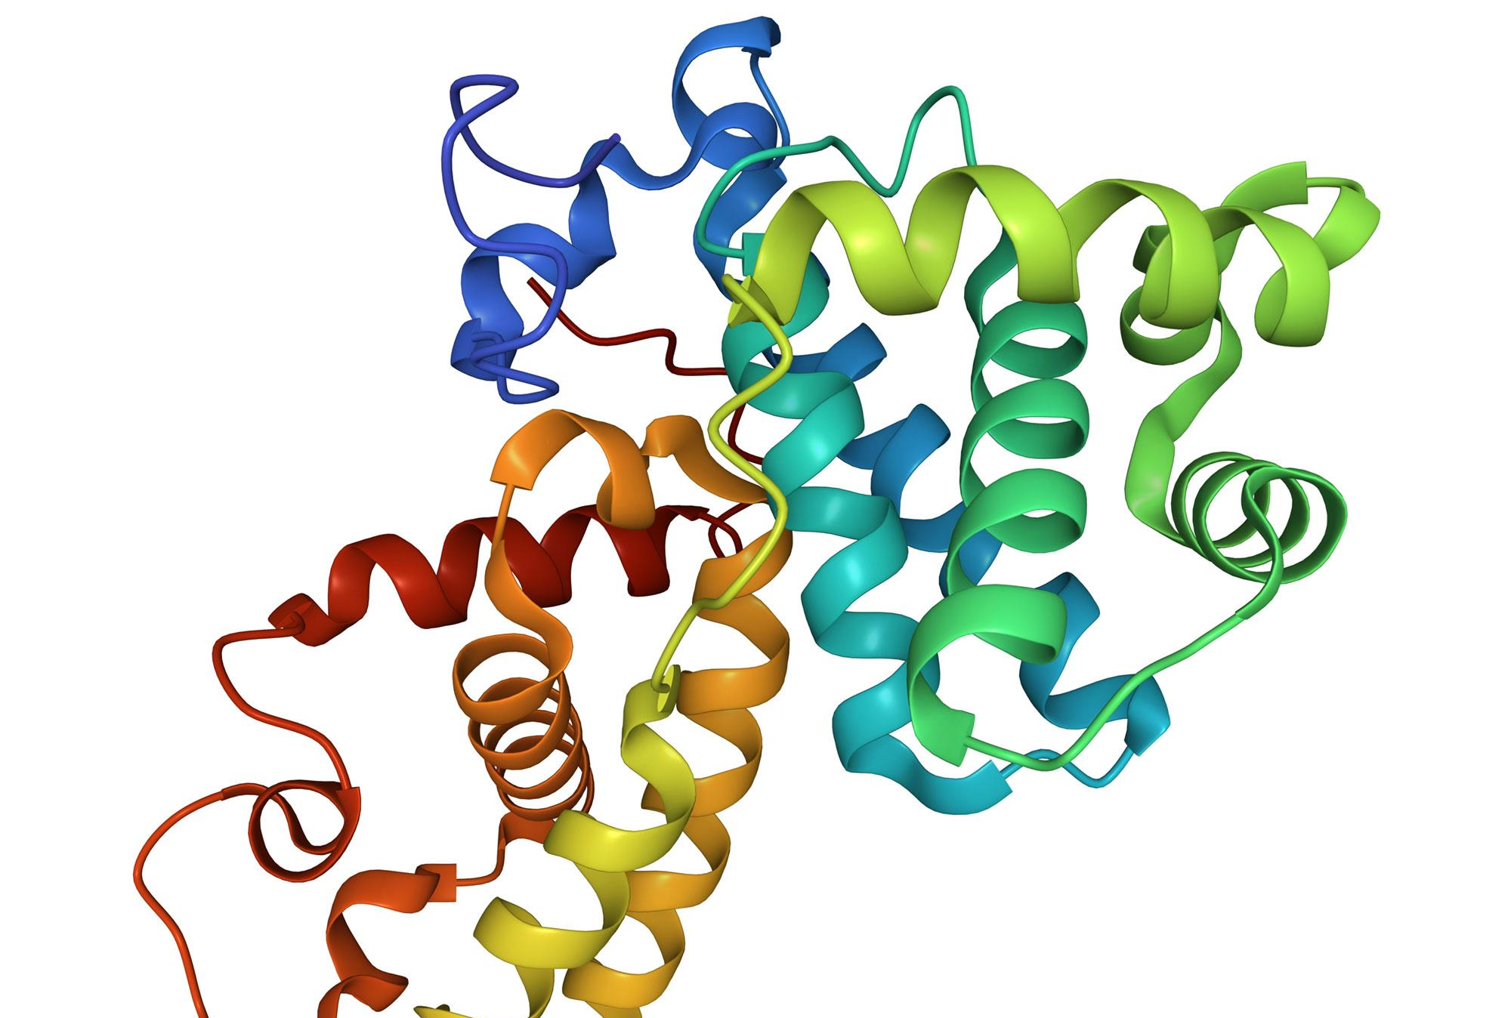
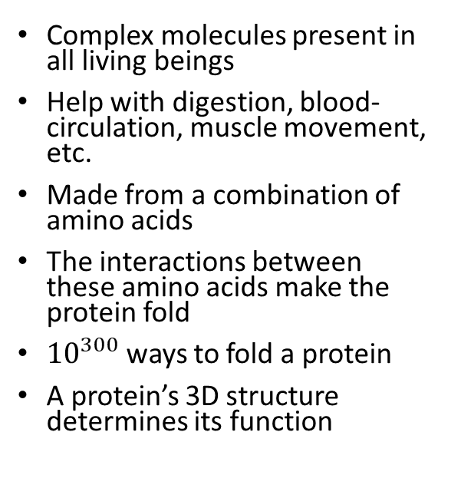
Proteins
Complex molecules present in all living beings
Help with digestion, blood-circulation, muscle movement, etc.
Made from a combination of amino acids
The interactions between these amino acids make the protein fold
${10}^{300}$ ways to fold a protein
A protein’s 3D structure determines its function

Slide 3
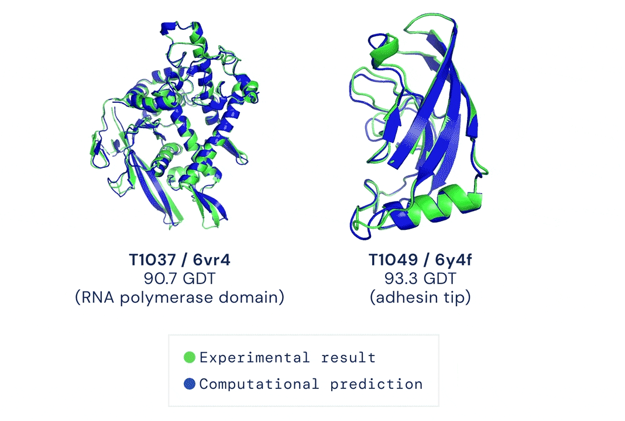
AlphaFold
Mapping a protein’s 3D structure using experimental methods is costly, time consuming and relies on extensive trial and error
Highly accurate system that predicts a protein’s 3D structure from just its amino acid sequence
Performance similar to experimental methods
Released predicted protein structures predictions covering almost the entire human proteome (98.5%)

Slide 4
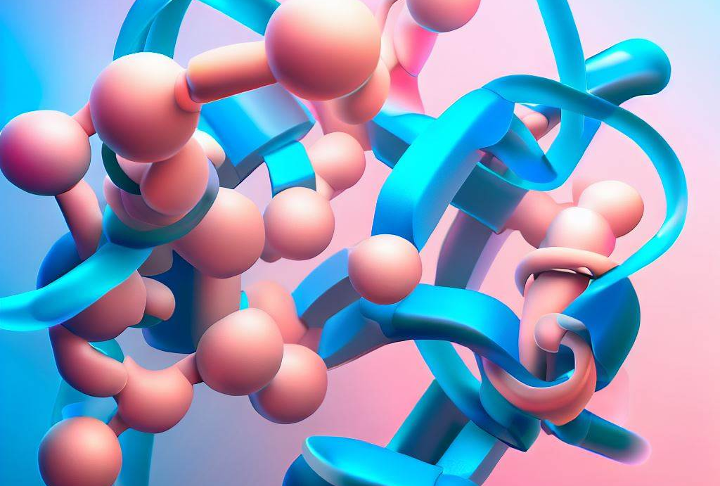
What are Drug-Target Interactions (DTIs)?
Interactions between drugs and proteins
Take the form of a temporary binding moving through the bloodstream together
Can be thought of as two puzzle pieces interlocked together

Slide 5
Why are they important?
Play a crucial role in drug discovery and pharmacology
Drug designers use this process to target diseases and tumours
Unexpected DTIs can cause severe side-effects

Slide 6
Why do we need predictive models?
Experimental determination of DTIs is costly and time-consuming
High-throughput predictive models can test thousands of drug-protein pairs cheaply and efficiently
Models could also lead to a better allocation of resources for those pairs that are worth looking into further

Slide 7
Past Studies
Jiang et al. used two different graphs, one created from a drug’s SMILE notation and another created from a protein’s contact map that were then fed into two GNNs to obtain their representations. These representations were then concatenated and used to make DTI predictions.
Gligorijevic et al. used a task-agnostic language model to extract features from protein sequences and again protein contact maps to create a protein graphs. These were then fed into a GCN and used to make predictions about molecular functions.

Slide 8
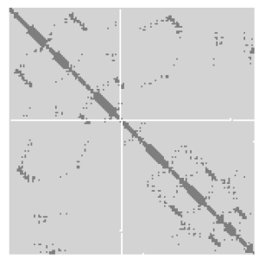
Contact Maps
2D representation, usually a matrix, of a protein's 3D structure
Can be passed directly to a GNN as an adjacency matrix
More formally, the contact map of a protein sequence indicates whether corresponding residue pairs are in contact or not, i.e. have a Euclidean distance less than a set threshold, usually 6, 8 or 10 Angstroms
Angstroms are a unit of measurements for the distance between atoms.

Slide 9
Objectives
Gather a new DTIs dataset
Extract protein structural embedding using AlphaFold’s predictions
Train models using the QSAR descriptors of drugs and proteins in addition to the structural embedding to predict whether they bind together
Evaluate the models’ performance
Build rudimentary system using the trained models

Slide 10
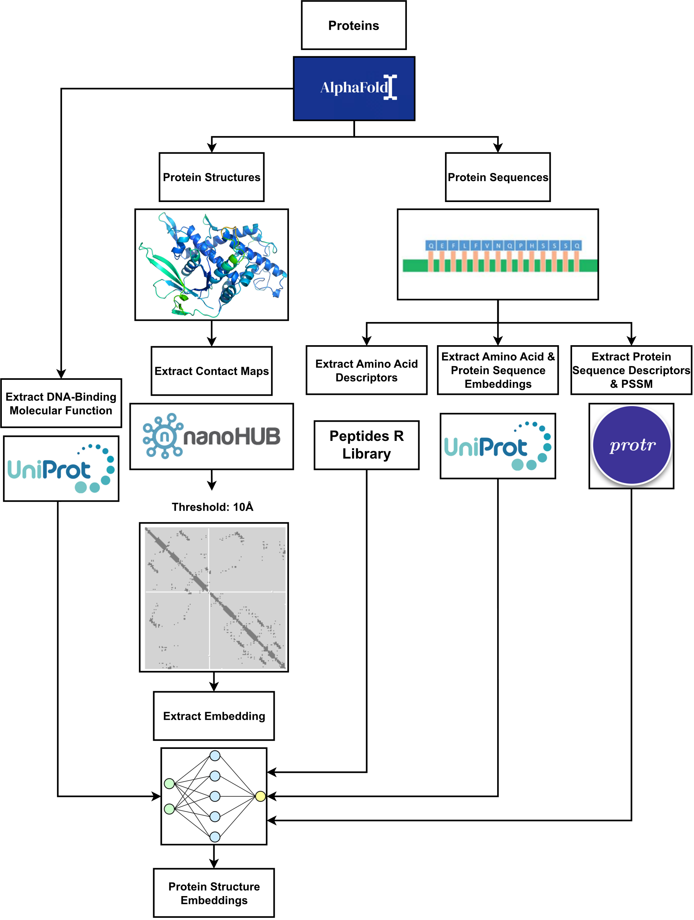
Structural Embeddings Methodology
11,034 unique proteins present
Label: “DNA-Binding” molecular function

Slide 11
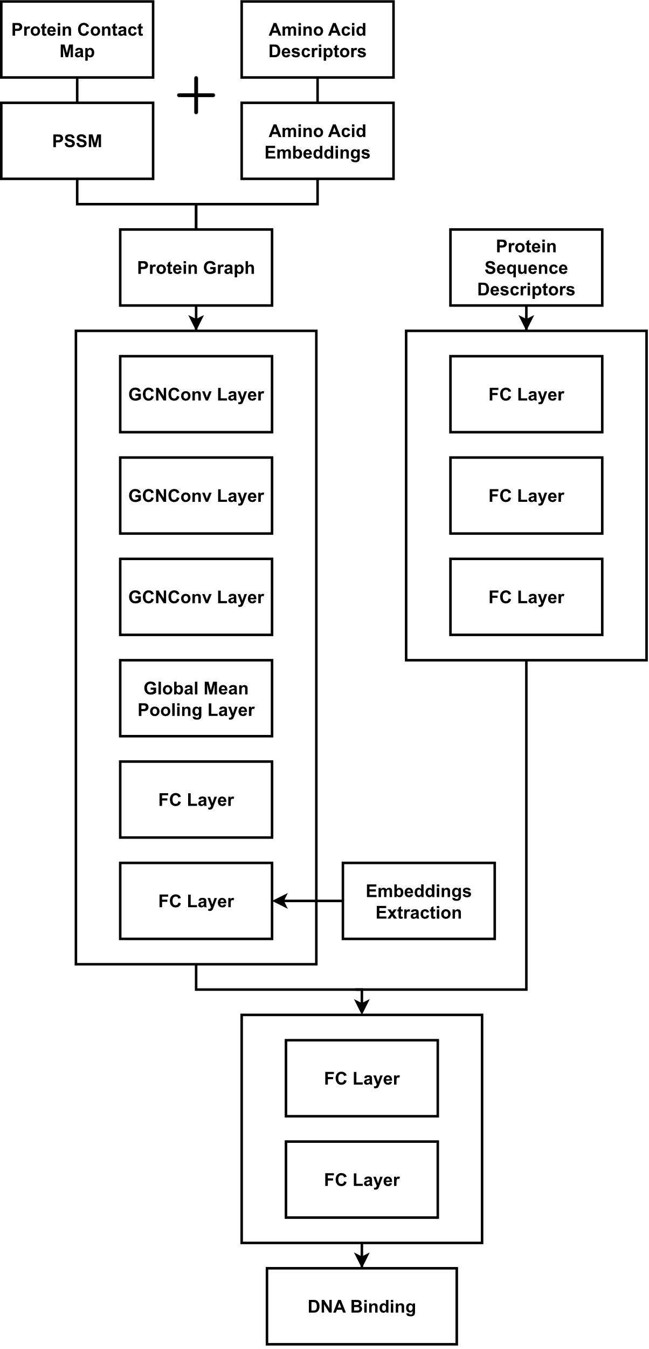
Structural Embeddings Model
Embedding extracted from second dense linear layer before the concatenation

Slide 12
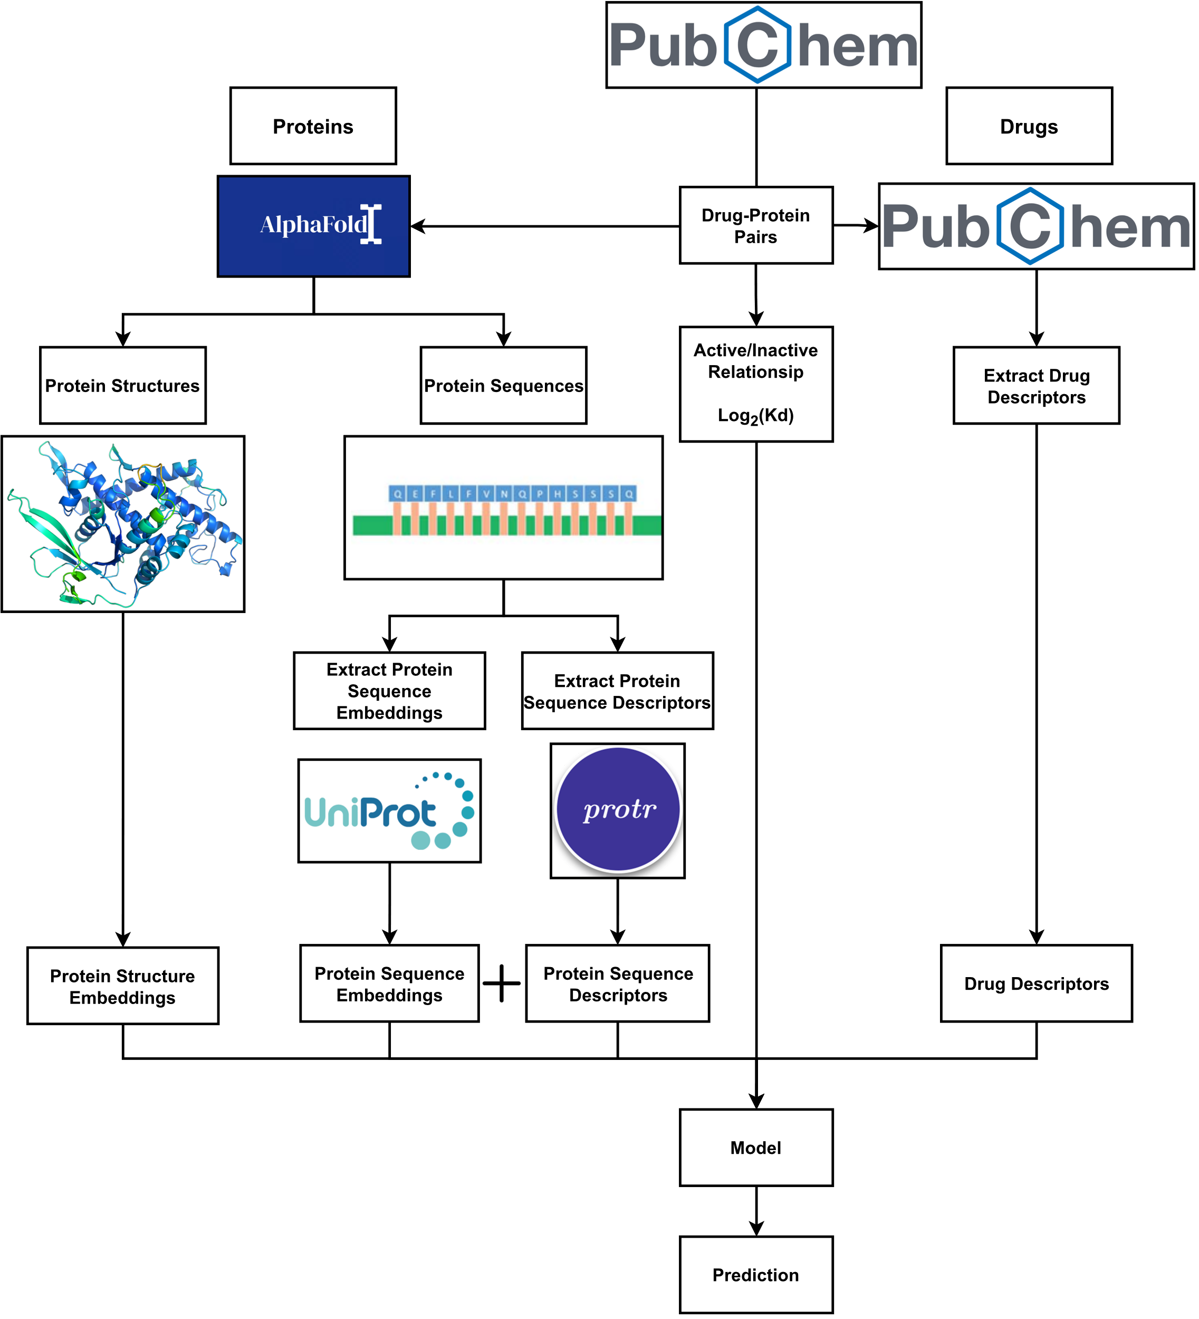
DTIs Methodology
163,080 DTIs gathered
3,459 unique proteins present
99,948 unique drugs present
Classification label: Binary
Regression label: LogKd (Used to measure binding affinity)

Slide 13
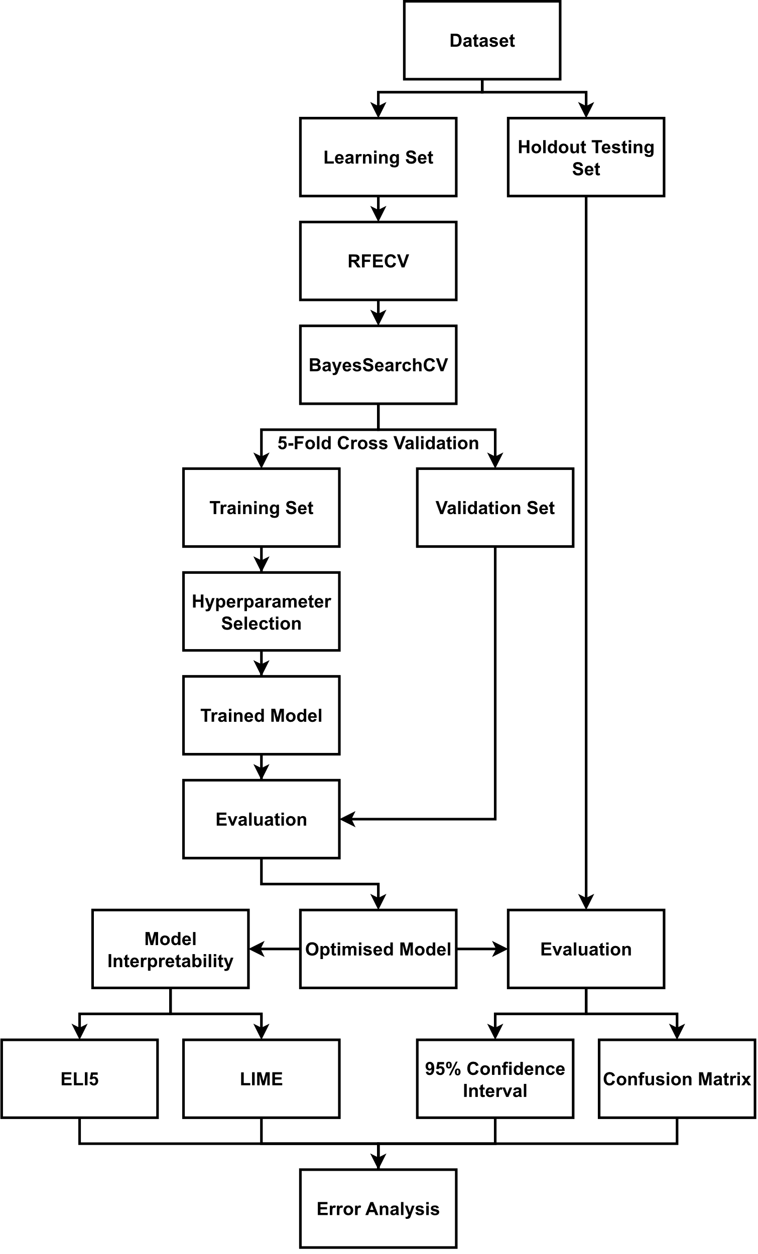
DTIs Model Training
Both classification and regression
Split into “Baseline” & “Enhanced”

Slide 14
Classification Models

Slide 15
Regression Models

Slide 16
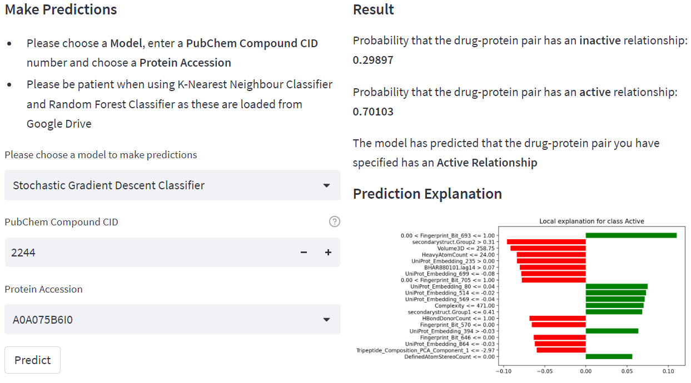
Streamlit App
Created to showcase our work
Allows users to use the models to make predictions

Slide 17
Future Work
Expanding dataset
Include more entries with binding affinity available
Reducing class imbalance
Recalculating embeddings
Using a different threshold for the contact maps
Using an entirely different approach
Deep-dive analysis of model errors

Slide 18
Recap
Created a new DTIs dataset
Extracted structural embeddings from predicted protein structures
Split models into “Baseline” & “Enhanced”
Baseline models used QSAR descriptors of drugs and protein sequences
Enhanced models used the extracted structural embeddings in addition to the QSAR descriptors
The created embeddings proved to be ineffective but the models could still prove useful
Streamlit web app created to showcase our work

Slide 19
Questions?

